Slide 1
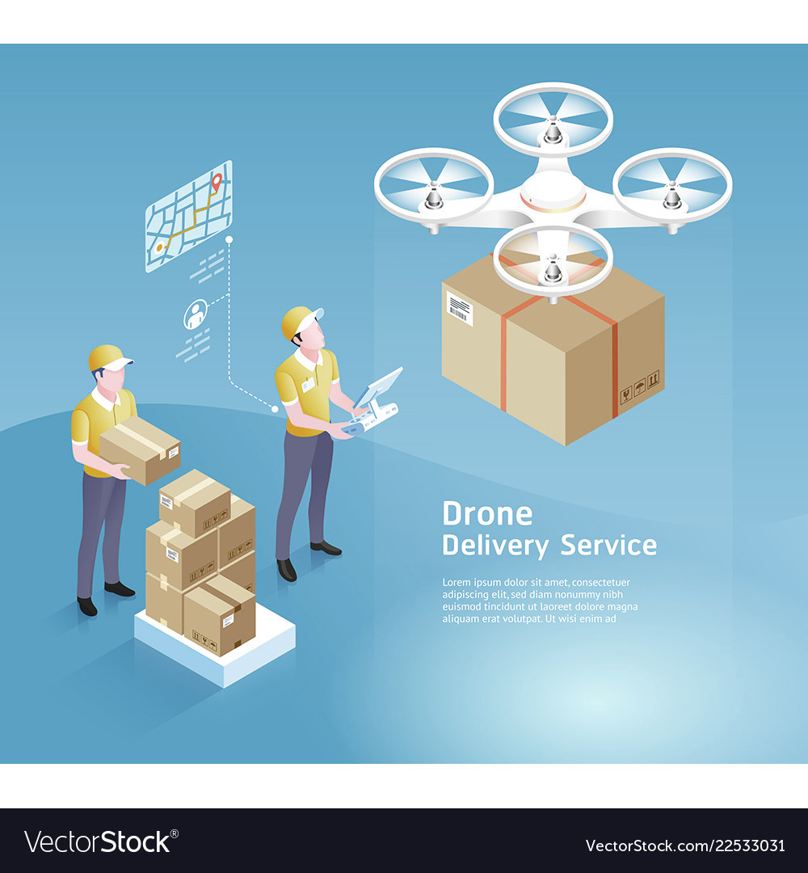
AIRWAY DELIVERY- A NEW PRESPECTIVE OF DELIVERY
Pandemic creates a new kind of demand for logistics services, so we are trying to keep up with that demand

Slide 2
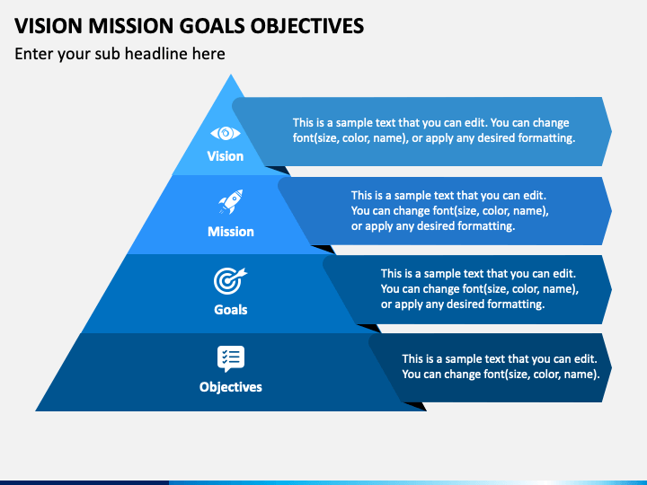
To creates a new kind of demand for logistics services, so we can be a market leader.
AIRDROP’s mission is to provide every user of India with instant access to vital medical supplies and desired food to their door steps.
To achieve Break-Even within first year of operations
Brand Establishment.
Innovation in processes and product to become Market leader.
Value of cost and time
Reliable
treat every customer delivery as though it is meant for someone you love..

Slide 3
CEO
PROJECT LEADER
FINANCE DEPARTMENT
HUMAN RESOURSE DEPARTMENT
INFORMATION TECHNOLOGY DEPARTMENT
MARKETING AND SALES DEPARTMENT
Provide information to management
Manage Equity.
Cash flow management.
Tax management.
Budget preparation and forecasting.
Recruiting required position.
Hiring.
Compensation.
Training organization.
Development
Administration
Technical support
Communication
Programming
Company website
Application development
Product, Pricing and Distribution Planning.
Customer Service and Sales.
Promotions and Marketing.
Public Relations.
Campaigning.

Slide 4
PRODUCT
the product offered is a high-speed and efficient high-flying drone delivery service.
PRICE
pricing for drone delivery is traditionally lower than other methods because the drones are electrical.
PROMOTION
These include advertisements, search engine optimization, social media, and public campaigns, particularly to local.
PLACE
The company AIRDROP Enterprises is based in India. It will operate in the large cities of India.
POSITIONING
MARKETING AND SALES
STRENGTH
the main advantage of the implementation of this technology is the projected time of delivery.
WEEKNESS
the current technology limits the flying and carrying capabilities of the drones.
OPPORTUNITIES
The collaboration with suppliers and developers of this technology creates the opportunity to enter a market and be a leader.
THREATS
one of the greatest obstacles in the wider implementation of transportation via drones is the current and future legislation
SWOT ANALYSIS
By package size
By type
Segmentation
By end use
By Region
CHALLENGES
Talent availability for scaled operations:
Infrastructure:
Public acceptance
Legislative and regulatory issues:
1
2
3
4

Slide 5
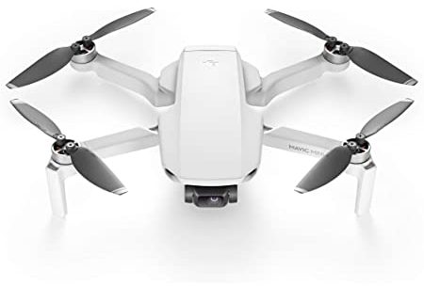
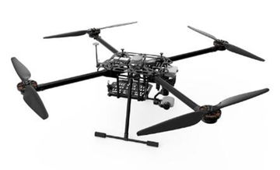
INFORMATION TECHNOLOGY-
WORKING MODULE FOR DRONE
WAREHOUSE
INCREASE ALTITUDE
LOWER ALTITUDE
INITIAL USER LOCATION
Extract current location
Coordinates provided by users
User location estimation
FALSE
QUADCOPTOR DRONE
Go to user location
Send OTP to confirm user
Check OTP
MULTIROTOR DRONE
TRUE
Delivery
Lower altitude

Slide 6
FINANCE MANAGEMENT
FIRST YEAR BUDGET ALLOCATION(2021-2022)
Sr no | Description | Value (INR)
A | Fixed Cost | 100000000
B | No. of Services in a year | 610000
C | Net sales cost per service (Avg order) | 200
D | Net Sales = ( B x C) | 122200000
E | Variable cost per service | 15
F | Total variable Cost = (B x E) | 9150000
G | Contribution = ( Net Sales – Variable Cost) | 112850000
H | P/V Ratio (CMR) = ( Contribution / Net Sales) x 100 | 92.5
I | Break Even Point (Sales) = ( Fixed Cost / ‘P/V Ratio’) x 100 | 108108108
J | BEP (Months) | 10.63 Months
BEP : INR 108108108
10.63 Months

Slide 7
HUMAN RESOURCE MANAGEMENT
RESPONSIBILITIES

Slide 8
CONCLUSION
After researching, studying and forecasting on India’s need and overall budget plan we can conclude that AIRDROP company has a potential to grow in future and generate revenue with increasing graph. By using marketing and sales strategies and business model run by departments it will be very easy to educate people about innovation of system and new services of the company. The key to its success is to continuously collaborate, innovate, and retain its talented workforce!

Slide 9
THANK YOU

